Slide 1


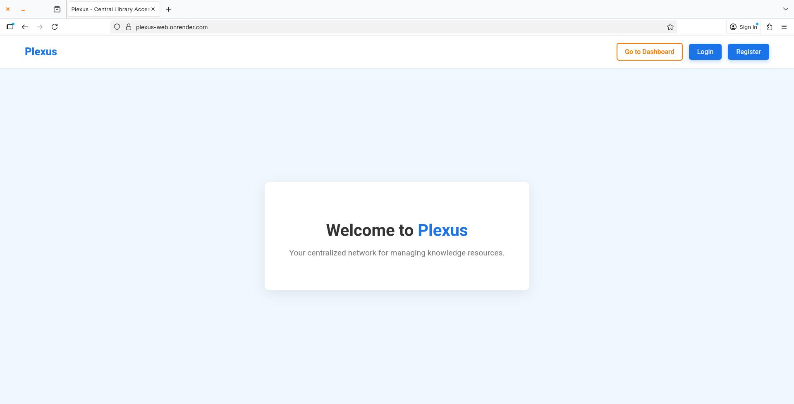
Plexus
•
Plexus.
A Centralized Network for Modern Knowledge Resource Management

Slide 2
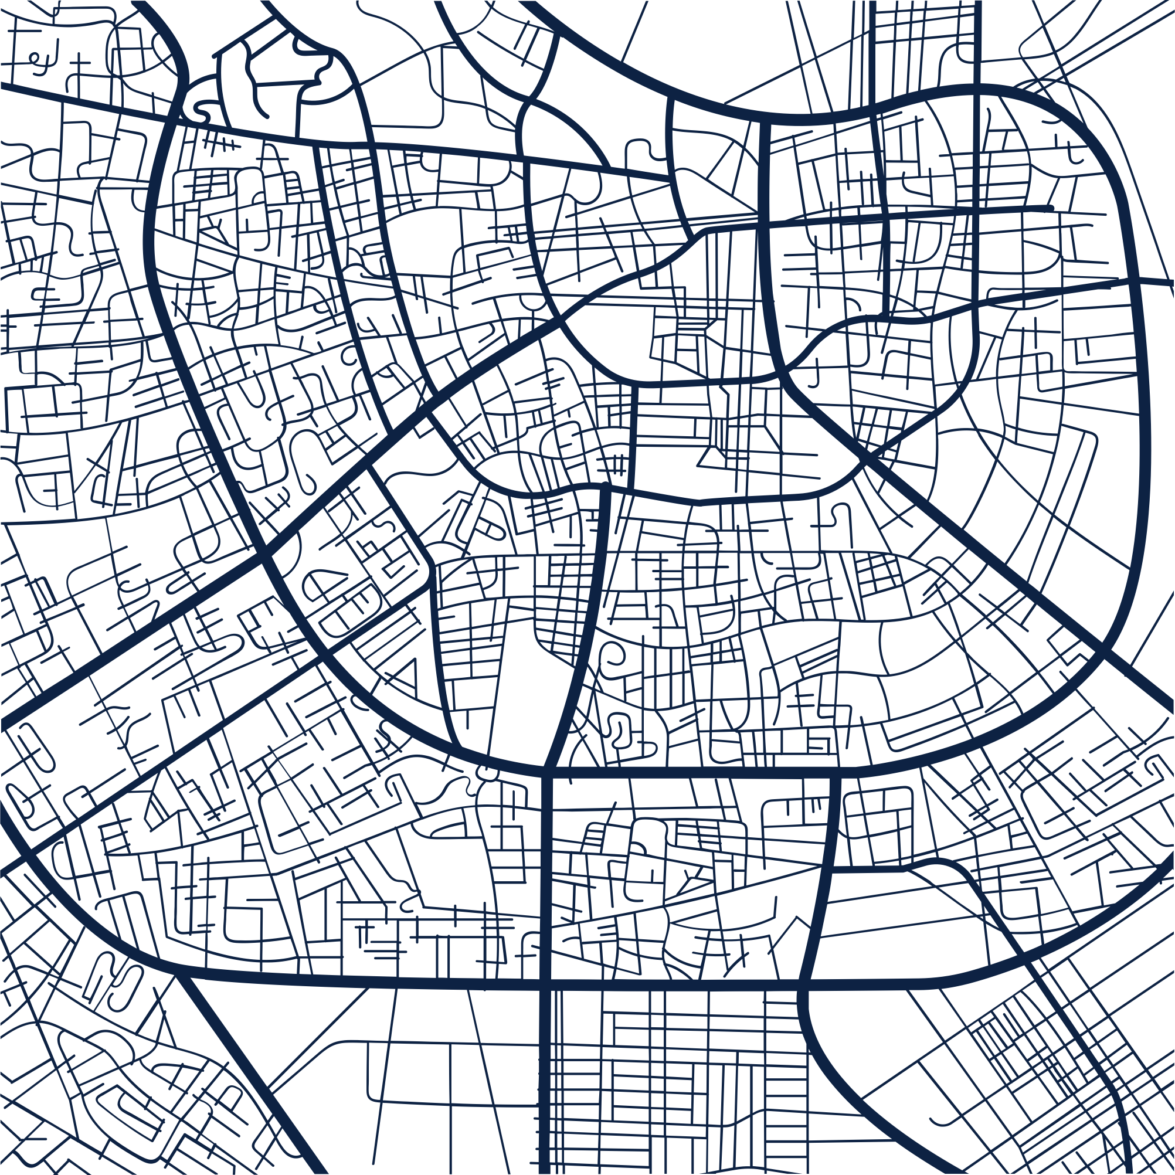

Plexus
•
Addressing the Challenges: Problem & Goal
The Challenge with Traditional LMS:
Plexus: Our Solution & Objectives:
Manual Overheads: Relying on physical records or outdated software leads to slow processes and increased workload for staff.
Error Prone: Manual data entry and human calculation of late fees result in frequent errors and disputes.
Lack of Accessibility: Students cannot check book availability or submit requests outside of library operating hours.
•
Centralization: To create a single, secure digital platform for all library activities.
Automation: To automate core tasks like borrowing requests, tracking due dates, and fine calculation (making it flawless).
Efficiency: To enhance the overall speed and accuracy of resource management for both admins and students.

Slide 3
Plexus
•
Meet the Plexus Development Team
Team Leader
Maruf Hasan
Lead Architect
Team Member 2
Moneruzzaman Asif
Database
Team Member 3
Ferdous Hasan
Frontend
Team Member 4
Rohan Basar Siddiq
Testing

Slide 4
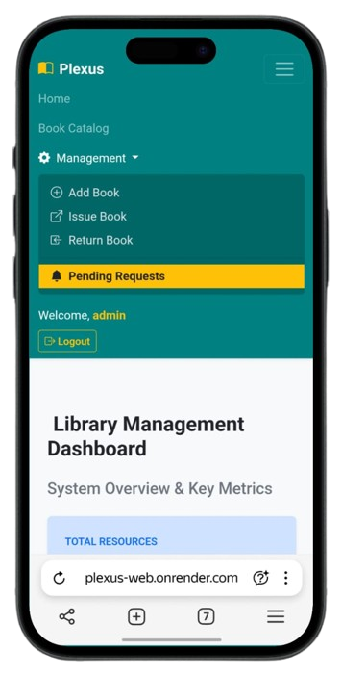
•
Plexus
•
Core Functionality: Administrator Tools
Plexus provides robust control over the entire inventory and user base.
• Resource Management (CRUD): Complete functionality to Create, Read, Update, and Delete records for Books and Authors.
• Centralized Request Handling: A single dashboard to Approve, Reject, or track all pending borrowing requests.
• Issue & Return Control: Automated system to manage book status, streamline returns, and ensure accurate record keeping.
• User Management: Comprehensive tools to oversee and manage all Student Accounts.

Slide 5
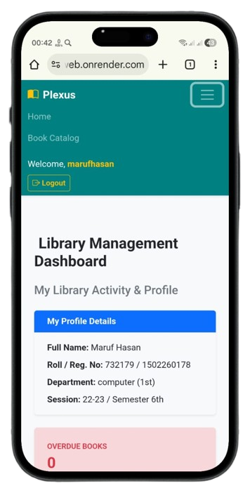
•
Plexus
•
Core Functionality: Student Features
Empowering students with 24/7 access to knowledge resources.
• Secure Authentication: Easy and secure Login/Registration to ensure personalized access.
• Real-Time Book Catalog: Browse, search, and check real-time availability of every book in the library.
• Online Borrowing Requests: Submit requests directly via the web portal from anywhere.
• Personal Issue Tracking: Students can view their entire history, current issued books, due dates, and calculated Fines.

Slide 6






Plexus
•
Technology Stack: The Foundation of Plexus
Backend Framework
Database
Language
Django
SQLite3
Python
Frontend
Frontend
Frontend
HTML5
CSS3
Bootstrap 5

Slide 7

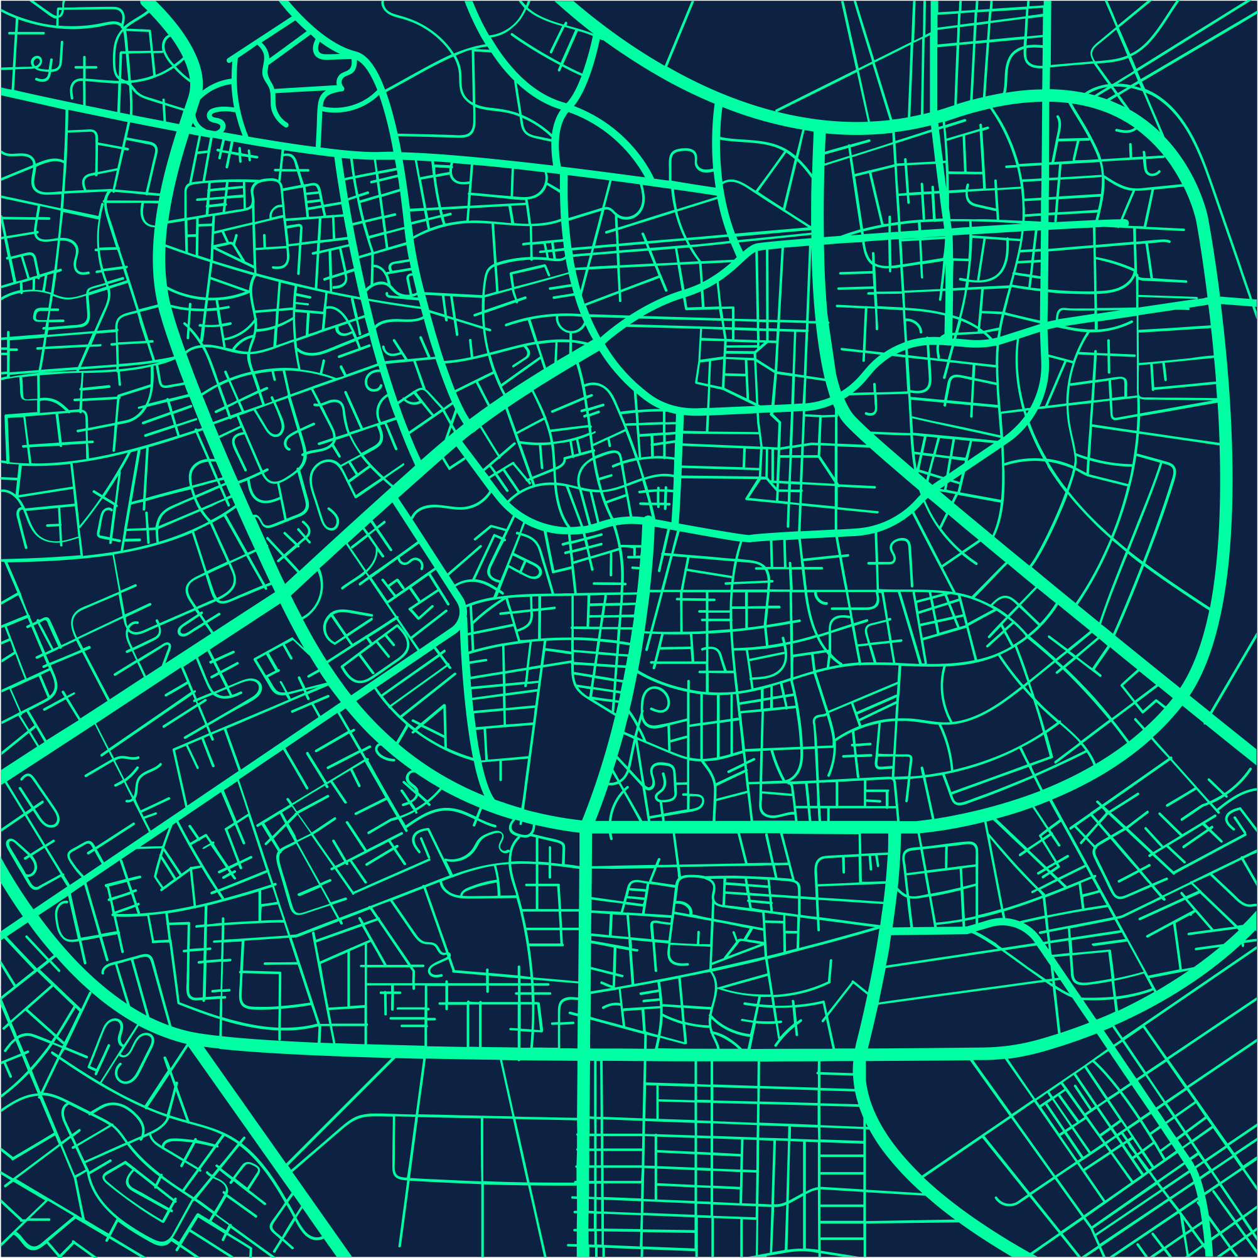
Plexus
•
System Architecture

Slide 8
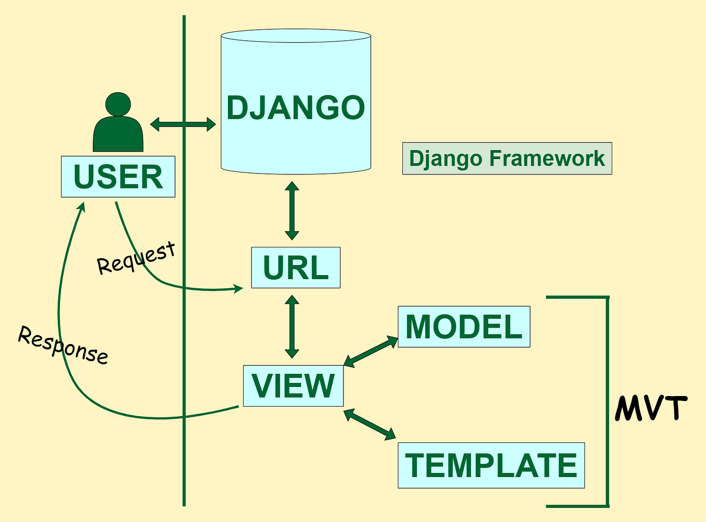
Plexus
•
Architecture:
The MVT Pattern in Plexus
Key Components:
1. Models (models.py): Data Structure. Defines the database schema and relationships (e.g., Foreign Keys).
2. Views (views.py): Business Logic. Handles all user requests, authentication, and core functions like Fine Calculation.
3. Templates (.html): User Interface. Renders the final HTML output for the user.
Benefit: Clear separation of concerns ensures modular, maintainable, and testable code.

Slide 9
Plexus
•
Demonstration Walkthrough: A Step-by-Step View
1
2
3
The Student Experience (Request)
Seamless Admin Workflow (Approval)
Automated Return & Fine Logic
Log in, browse the real-time catalog, and submit a book borrowing request online.
Showcase the Admin Dashboard, approve the pending request, and demonstrate inventory status update.
Process a book return and highlight the system's ability to instantly and accurately calculate overdue fines.

Slide 10


Plexus
•
Live Demonstration
Plexus: Experience the Digital Library

Slide 11
Plexus
•
Conclusion & Future Roadmap
Key Achievements:
Next Steps for Plexus:
• Accuracy: Automated core financial logic (Fine Calculation), eliminating manual errors..
• Efficiency: Streamlined book issue/return processes, saving significant staff time.
• Accessibility: Provided 24/7 online access to the catalog and personal issue tracking.
• Integrated Payments: Implement online payment for overdue fines directly through the portal.
• Advanced Analytics: Add graphical reports for detailed analysis of book trends and financial summaries
• Notification System: Implement email/in-app reminders for approaching due dates to reduce late returns.

Slide 12

Plexus
Thank You
•
Innovating Library Management for the Digital Age.
Seamless Experience: For both Students & Admins.
Precision & Efficiency: Automated operations, zero errors.
Future Ready: Scalable for advanced features.
Connect with Us: Email: maruf.chats@yandex.ru
GitHub: exploremaruf

